Slide 1
Payroll Services
Fund Change & Direct Retro
Michelle Snyder, Payroll Director – Payroll Services

Slide 2
Overview
Fund Change
Distribution of Payroll Expense (DOPE)
Direct Retro
UCPath Review

Slide 3
Outcomes
At the end of this session, the learner will be able to…
identify the location of the Fund Change Form
understand the function of the Fund Change Form
understand the relation of the Distribution of Payroll Expense (DOPE) report to the UCPath Direct Retro process
understand nuances within the DOPE
complete/submit a fund change request
complete/submit a Direct Retro request
review a Direct Retro action status in UCPath

Slide 4
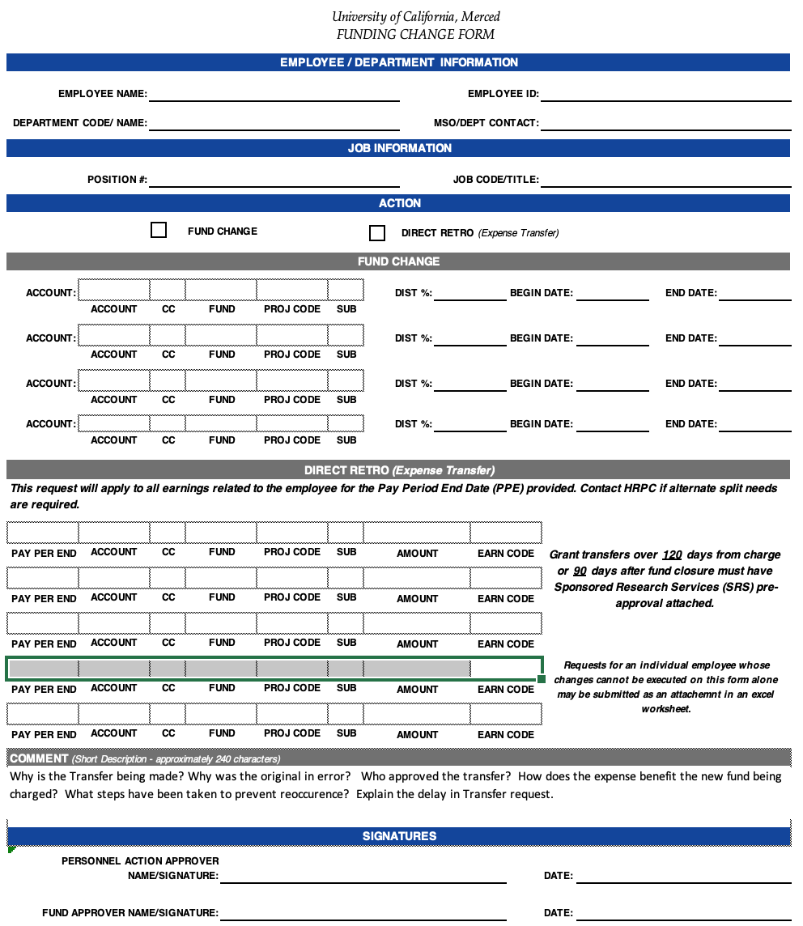
Funding Change Form (Direct Retro Request)
Located on the Payroll Services Website
under the “forms” link on the left side of the page
Used to facilitate a request to Payroll Services to prospectively change position funding (Fund Change)
and/or
To request realignment of previously posted earnings (Direct Retro)

Slide 5
Fund Change
Prospective change to the funding source(s) assigned to a specific position

Slide 7
The total of all effective dated distribution lines MUST equal 100%
Be mindful when requesting entry of fund end dates as it is the department’s responsibility to update funding before the last cycle ends to avoid charge to payroll suspense account.

Slide 9
Considerations
Funding must be fully validated
1
Project code must be part of the active chart string
If not valid, Payroll Services will process your fund request, MINUS the project code
A courtesy notification to the requesting department will be provided via email if a project code does not validate.
Department is responsible for any additional action requests if a project code is needed
2
Sub will default based on employment type
3
Example: Career employee will default to sub 01. Override to sub 02 must be identified on the form, if necessary

Slide 10
Submit to Payroll Services via email payrollservices@ucmerced.edu

Slide 11
DIRECT RETRO
Direct Retro is the process within the UCPath system used to move salary expense(s) from one or more fund sources to another fund source(s).
Previously referred to as a “Salary Cost Transfer” or “Expense Transfer”

Slide 12
Funding Change Form (Direct Retro Request)
Located on the Payroll Services Website
under the “forms” link on the left side of the page
Used to facilitate a request to Payroll Services to prospectively change position funding (Fund Change)
Or
To realign previously posted earnings (Direct Retro)

Slide 13
DOPE vs Direct Retro
Direct Retro in UCPath does NOT always mirror the line items as reflected on the DOPE report
The labor ledger (DOPE) will reflect the breakdown of gross earnings, vacation used and the credit associated with the vacation use.

Slide 14
Pay Period vs Earning Period
Pay Period = The cycle the earnings POSTED to
Example: Monthly earnings 1/1/19-1/31/19 posts to the PAY PERIOD 1/31/19
Vacation take in December 2018 (EARNING PERIOD 12/31/18) is reflected on the PAY PERIOD 1/31/19 as monthly paid employees report leave usage in arrears
Can have pay and report leave usage from prior earning periods
Earning Period = The cycle the earnings were PAID (earned) for
Example: Bi Weekly earnings 12/30/18-1/12/19 posts to the PAY PERIOD 1/12/19
ALL earnings are broken down by pay type (vacation, sick, comp taken, holiday, reg, etc.)
Leave is not generally reported in arrears
Can have prior earning period pay on the same pay period

Slide 15
MONTHLY EXAMPLE

Slide 16
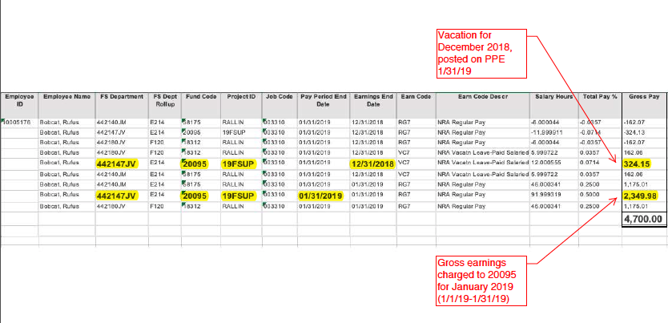
To determine the amount available for transfer
Use total gross for the pay period, minus the vacation use recorded in the particular Pay Period to determine the dollar allocation for each FAU
The actual vacation pay should be considered when determining what amount you request for transfer on the HRPC direct retro form.
DOPE Report for Pay Period Ending 1/31/2019
20095 line referenced for training purposes. ALL earnings must be reflected when requesting a Direct Retro

Slide 17
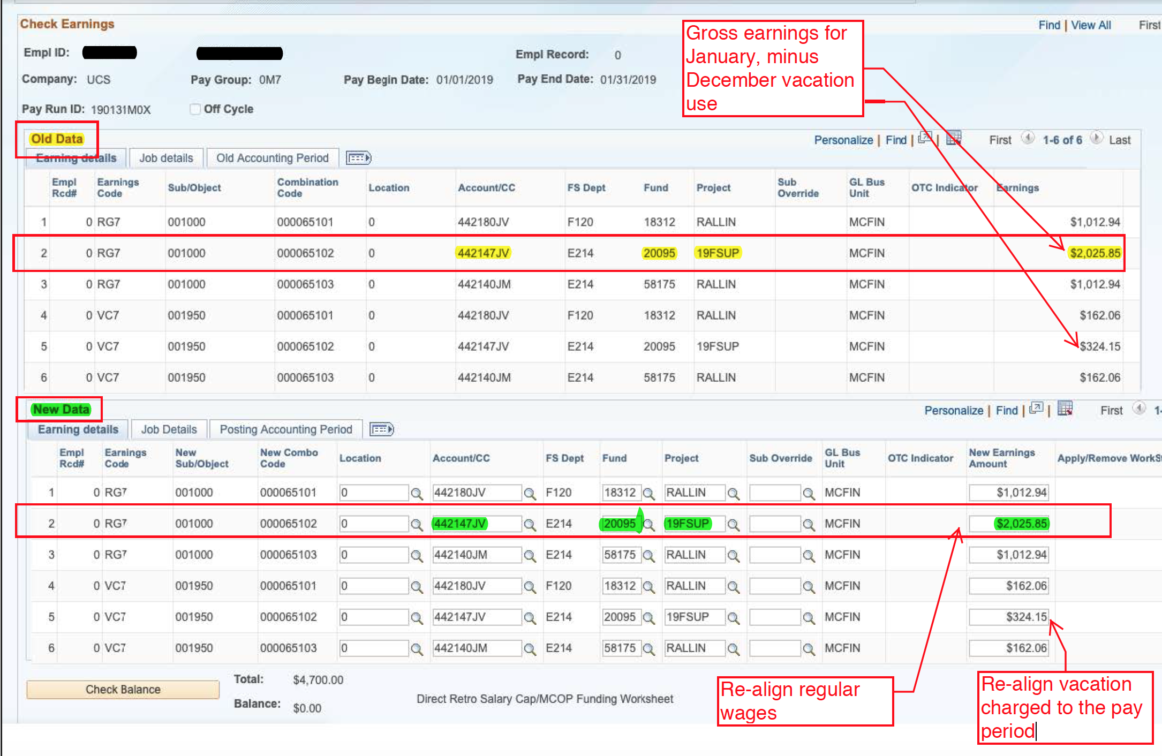
UCPath Direct Retro Module for Pay End Date 1/31/2019
Example: 20095 Line Only
Pay End 1/31/19 (DOPE) $2349.98 REG
Earnings reduction
for vacation use for
Earnings End 12/31/18 -$324.15 REG
= $2025.85 REG
Vacation use for 12/31/18 = $324.15 VCN
Available for
re-allocation $2025.85 REG
$324.15 VCN
Total for Pay End 1/31/19 $2349.98

Slide 19
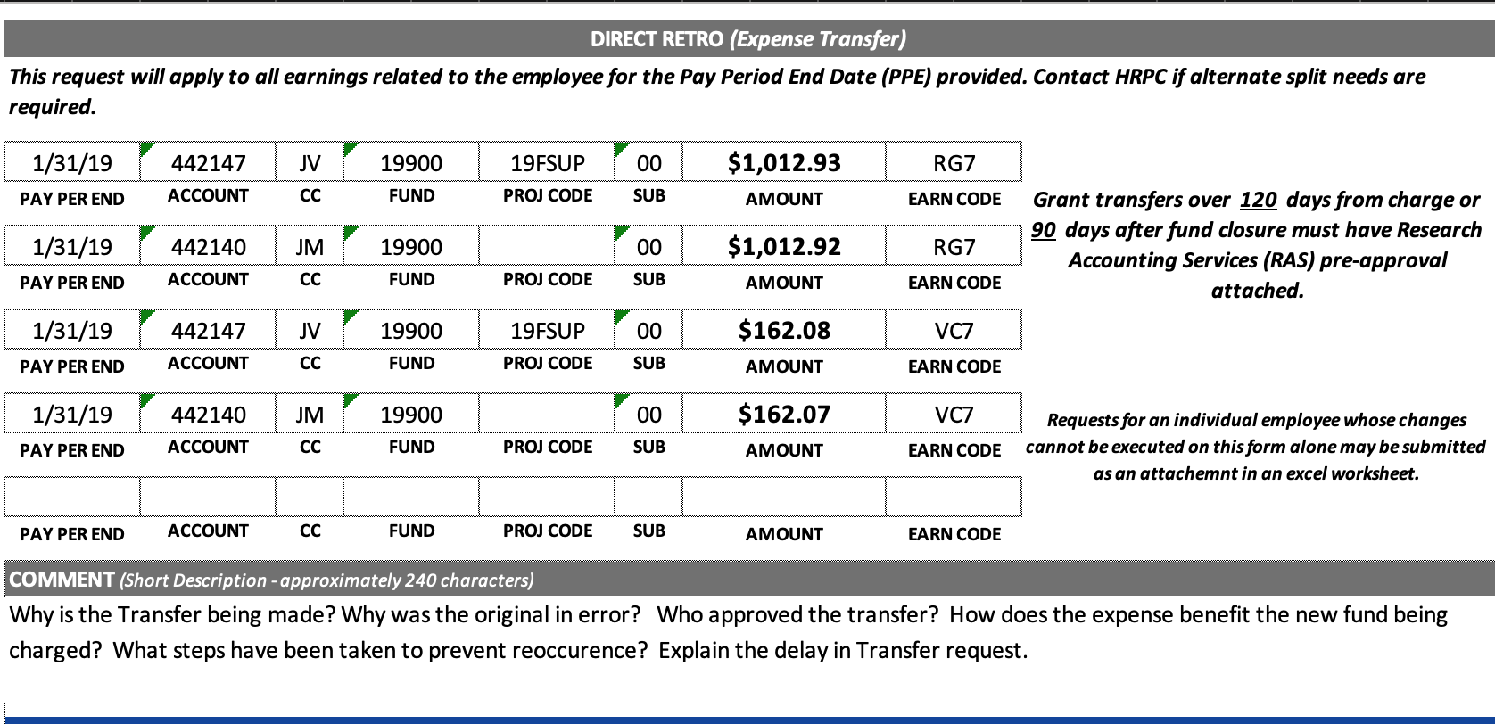

Slide 20
*ALL questions in the “comment” section MUST be answered if your Direct Retro request involves a grant fund and is subject to the 120/90 day review rule.

Slide 21
BI-WEEKLY EXAMPLE

Slide 22
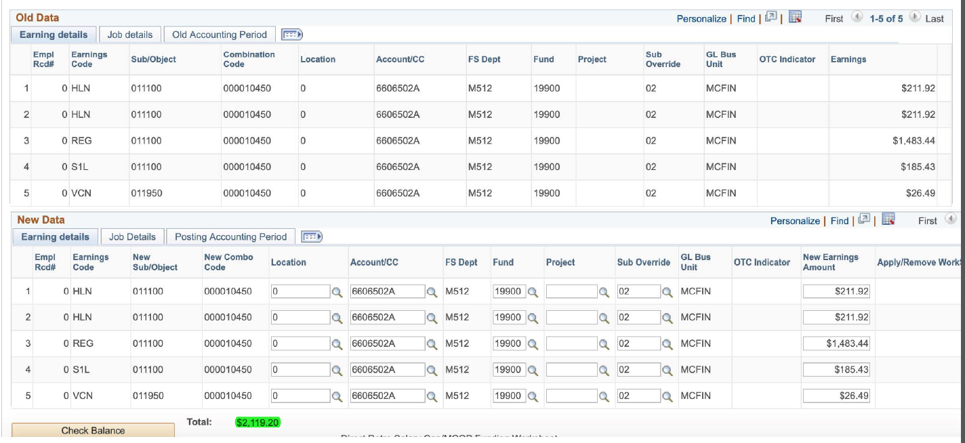
DOPE for Pay Period Ending 1/12/2019
UCPath Direct Retro Module for Pay End Date 1/12/2019

Slide 23
Submit to Payroll Services via email payrollservices@ucmerced.edu

Slide 24
What’s my Deadline?

Slide 25
“HRPC” has changed to “Payroll Services” effective 1/1/20

Slide 26
Transfer Considerations
Submissions for Direct Retro follow the same submission deadlines as all other pay impacting actions
Calendar for per cycle deadlines is housed on the Payroll Services website
Please reference the calendar on the website (vs downloading and referencing local to your computer or departmental drives) as changes to the calendar will ONLY be made to the online version.
Notification of calendar changes are NOT communicated to departmental contacts
Transfers requiring ORED approval may be delayed at least 1 cycle
Plan accordingly to avoid additional delays

Slide 27
Check Status

Slide 28
Peoplesoft…Payroll for North America…Payroll Distribution…UC Customizations…Review Retro Distribution

Slide 31
Resources
Payroll Services Website - https://bfs.ucmerced.edu/payroll-services
Payroll Services Email – payrollservices@ucmerced.edu *
ORED Contact: https://srs.ucmerced.edu/
* Please utilize the Payroll Services email address rather than contacting an analyst directly to ensure your request is handled timely.

Slide 32
Questions?

